Slide 1
SolarWinds Attack
By Thomas Hamilton

Slide 2
Who is SolarWinds
IT management company out of Austin, Texas
Provided network monitoring software
At the time of the attack they did not have a director for cybersecurity nor a director for information security
Flagship platform was Orion
Notes:
They provided network monitoring software to US Federal government and many other private businesses
They were warned multiple times that they should increase security but did not
Orion was used extensively before and during the attack and I’ll talk more about it later

Slide 3
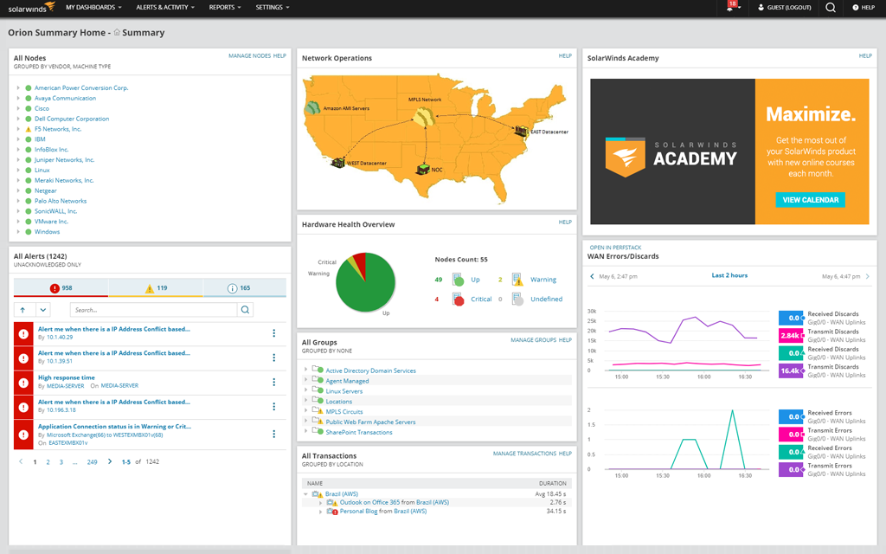
What is Orion
Flagship of SolarWinds and was used by many companies
Orion is a platform for managing resources easily
“Orion allows chief information officers (CIOs) to automate certain activities such as managing internet protocol (IP) addresses, monitoring devices, and deploying updates” (No Easy Fix, 2020)
Office 365 Account had been breached previously, but they continued to push updates using it
Notes:
Orion is a business management software that easily shows all information in an easily readable format on the right is what Orion looks like
SolarWinds pushed updates using its office 365 account that had been hacked into previously through a password allegedly set by an intern as SolarWinds123

Slide 4
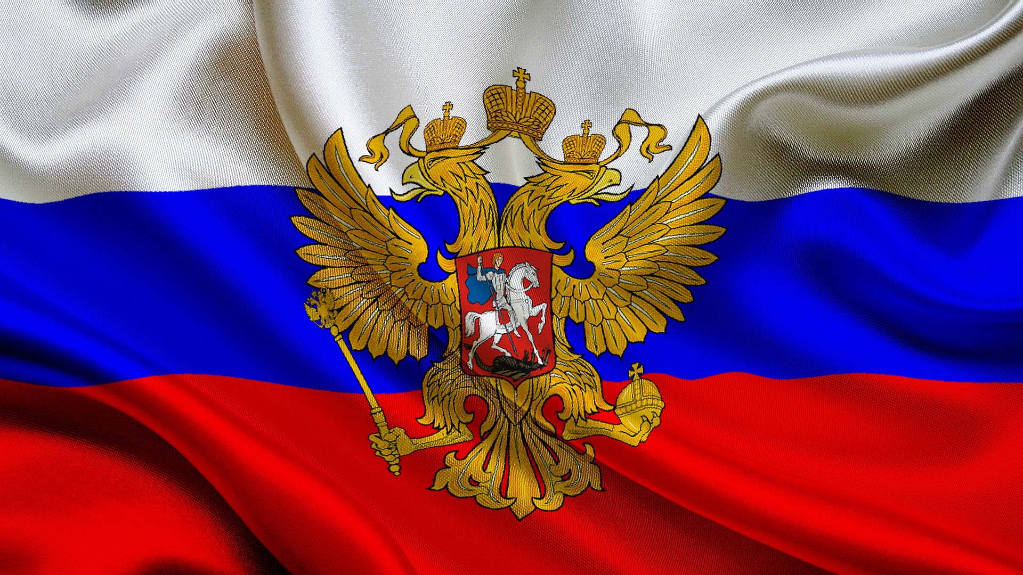
Who Was Responsible
The people that are the most likely to have caused this incident were the Russians
Almost all experts agree that it was the Russian SVR or one of the groups that are working for it
The most likely responsible is CozyBear, a group that works for the SVR
Though the president at the time Donald Trump claimed it was the Chinese nation
Though he did not have any factual evidence
Notes:
The ones responsible were never 100% guaranteed
Most likely are the CozyBear group out of Russia
They do work for the Russian SVR

Slide 5

The Attack
Supply Chain
Initial breach was in September 2019
First malicious code injected was in February 2019
This was coined Sunburst
Discovered by FireEye
Notes:
The attack was a supply chain attack which is damaging one link of the supply chain which will disrupt or stop all other links after it
The initial breach through the Office 365 account was in September of 2019 but they squatted on the server until they sent the first code in February of the following year
The attack was discovered by FireEye on December 8 of the same year. They were also the ones who named it Sunburst

Slide 6
How Did They Gain Access and What Did They Do
The most likely way was through a compromised Office 365 account
The password to this account was SolarWinds123 set by an intern
They then pushed code into the update that was then sent out to all networks using the Orion platform
The affected versions are 2019.4 through 2020.2.1 HF1
The tools used to get in were labeled SUNSPOT to match the theme of the sun
The NSA apparently did not know of the attack
Notes:
They pushed the malicious code into the stream of the normal Orion updates that were being released at the same time as them
The hotfixes to remove the malicious code was released six days later It was later discovered that the threat actor was able to breach some of Microsoft’s source code

Slide 7
Who was Affected
Those Affected include, Federal Agencies, but are not limited to
The NNSA or the National Nuclear Security Administration which monitors all of the nation’s nuclear arsenal
Department of Agriculture, Department of Defense, Department of Energy, which the NNSA is a part of, Department of Health and Human Services, Department of Homeland Security, Department of Labor, Department of State, Department of Transportation, and the Administrative Office of the United States Courts
Those affected include, private businesses, but are not limited to
Belkin, Cisco, Cox Communications, Equifax, Fidelis, FireEye themselves, Malwarebytes, Microsoft, Mimecast, Nvidia, Palo Alto Networks, Qualys, and Vmware
“This wave of attacks targeted approximately 3,000 email accounts at more than 150 different organizations. While organizations in the United States received the largest share of attacks, targeted victims span at least 24 countries” (The Fly, 2021)
Notes:
The Federal agencies one of them the NNSA which could be one of the main targets for the attack as they do monitor all of the nations nuclear stockpile
The attack also could have been to attack the most amount of people which it was able to do

Slide 8

Damages
Amount Unknown
Estimates range from a few billion dollars to hundreds of billions of dollars
The stock for SolarWinds dropped from $52 before the attack to only $8.38
Their net income also dropped from $164.8 million to -$929 million
Notes:
The amount is unknown but what is known is the amount of damage dealt to the SolarWinds company
They probably will not be in business for very much longer as most people have lost trust in them and there are operating at a massive deficit

Slide 9
Conclusion
You should always be ready to kill a software program no matter how needed it is
Always be scanning with an IDS, Intrusion Detection System, and an IPS, Intrusion Prevention System
Always stay up to date on all software unless it is known that the update is not as secure as the one running currently
Always stay up to date on knowledge of what software has a vulnerability that might be discovered or not
If something has been compromised kill it and go through an extensive check to see what the threat actor gained access to
Always have password policies in place to help protect against weak passwords
Notes:
You must be able to kill programs whenever they are breached or something else happens
Always have protections set up for defense against attacks
Stay up to date
Always be prepared and have knowledge
When breached go through and make sure to remove any way a threat actor can gain access back into the system
Never allow personal to be able to make easy to guess passwords

Slide 10
References
Baker, P. (2021, June 4). The SolarWinds hack timeline: Who knew what, and when? CSO Online. https://www.csoonline.com/article/3613571/the-solarwinds-hack-timeline-who-knew-what-and-when.html
Microsoft warns about cyberattack from actor behind attacks on SolarWinds. (2021). The Fly.
SolarWinds Attack -- No Easy Fix (IN11559). (2021).

